Slide 1


[Title]

Slide 2


Today's agenda
Project recap
Problem
The Analytics team
Process
Insights
Summary

Slide 3

Social Buzz is a rapidly growing content creation and social media technology that needs to adapt quickly to satisfy it’s growing global scale. Accenture has taken a 3 month POC focusing on the following tasks:
An audit of Social Buzz’s big data practice
Recommendations for a successful IPO
Analysis to find Social Buzz’s top 5 most popular categories of content
Project Recap

Slide 4


Problem
Over 100,000 posts per day…
~36,500,000 pieces of content per year
How to capitalize on all this content when there is so much?
Analysis to figure out the top 5 most popular categories of content on Social Buzz

Slide 5



Andrew Fleming
Chief Technical Architect
Marcus Rompton
Senior Principle
Colin Suarez
Data Analyst
The Analytics team

Slide 6
Process
1
Data Understanding
2
Data Cleaning
3
Data Modeling
4
Data Analysis
5
Uncover Insights
Notes:
We were given 3 datasets called Reaction Types, Reactions, and Content. We first explored each dataset to get an understanding of what data we have. The Reaction types dataset contained 3 features which were Type of reaction, the sentiment of the reaction and the score of the reaction. The scores ranged from 0-75. The reactions dataset contained 4 features which consisted of Content ID, User ID, type of reaction and datetime. The last dataset we used was the content dataset which contains 5 features. The features are Content ID, Content type, Category and URL.
The next step was data cleaning. We found that there were missing data in some of the rows of the dataset and we also found that some columns weren’t necessary for our data such as the User ID and URL columns. We also renamed the Type columns to be more specific and keep the columns distinguished from each other to make our data analysis efficient. We also found for the category column in the content database that some categories were the same but some were in quotation marks so we removed the quotation marks so that the we could aggregate the total for each category correctly.
After we finished data cleaning, we began our data modeling. We combined the 3 data tables into one data table by first using the reaction table as our base then joining the content table using content ID as the primary key then lastly we merged the reaction type table by using the reaction type as the primary key. Once we joined the 3 tables together, we found the top 5 most popular categories by finding the categories with the most aggregated popularity score.
We began our data analysis on these top 5 categories and were able to uncover some insights which we will dive deeper in the coming slides.

Slide 7

Insights
16
Unique Categories
1897
Reactions to “Animal”
Posts
May
Month with Most Posts

Slide 8
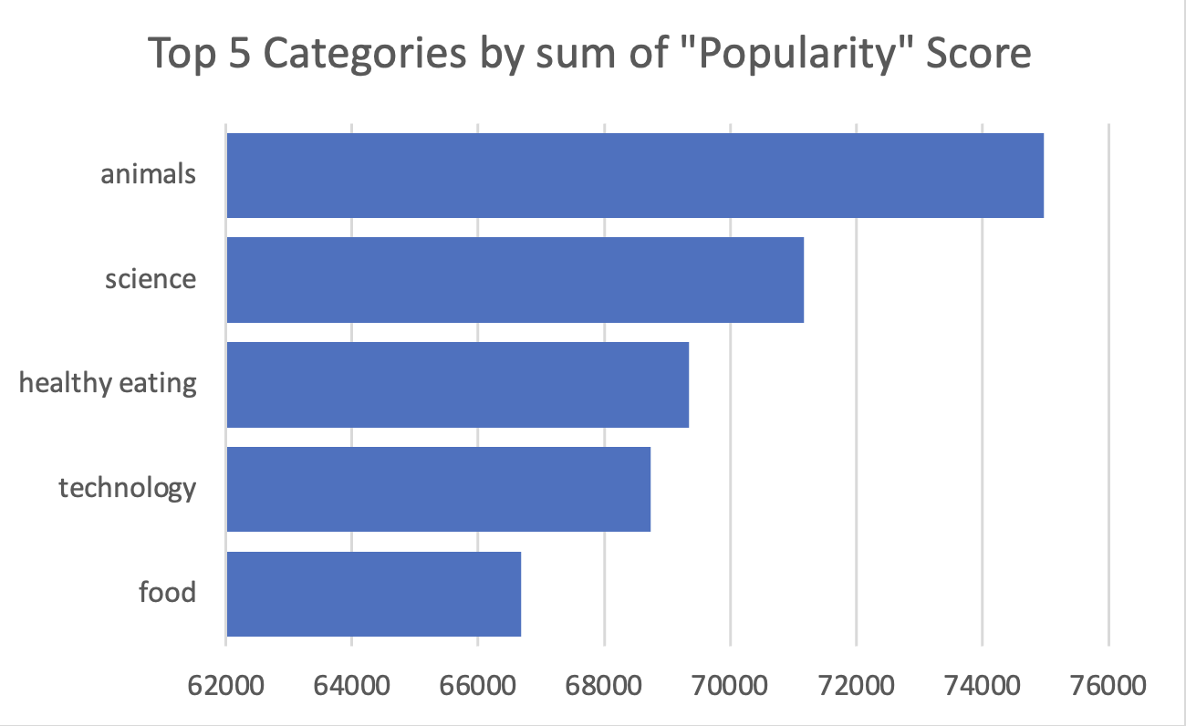

Slide 9
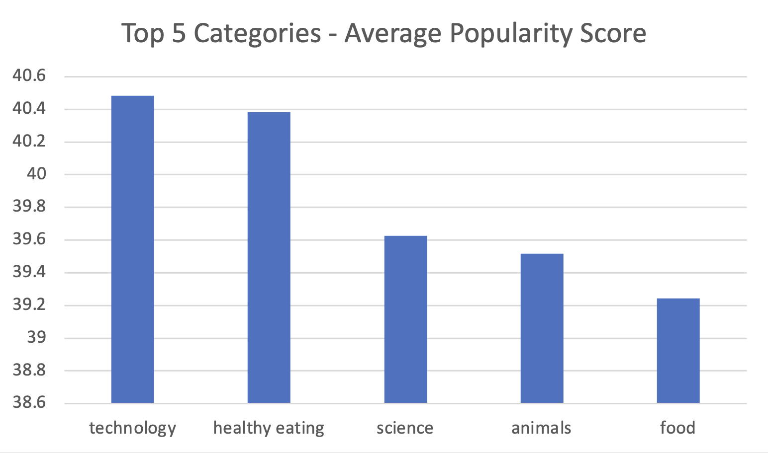
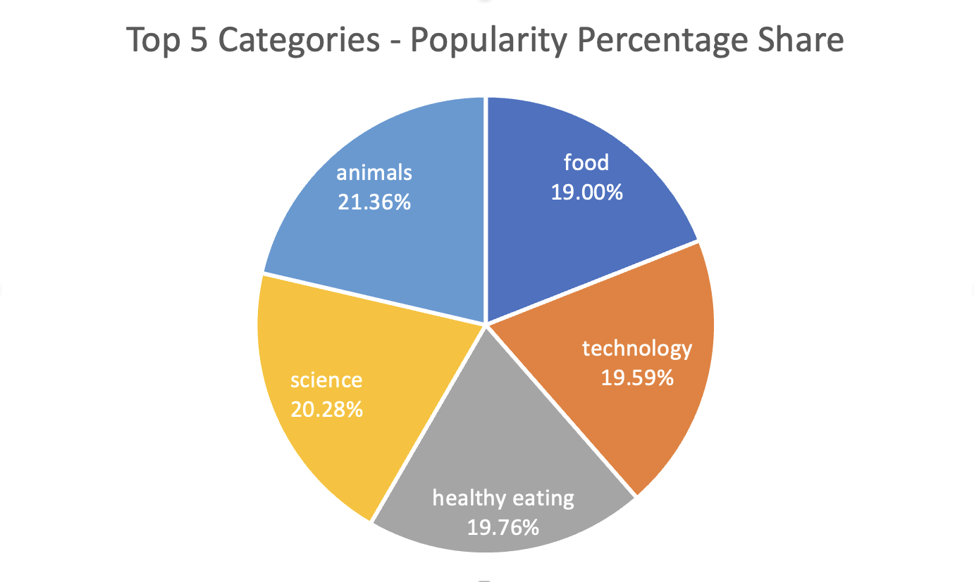

Slide 10

Analysis
People enjoy the animals and science categories of content the most which means that people like “non-fictional” content the most.
Insight
Food and “Healthy Eating” are similar top 5 categories. This shows that the audience within the user base are invested in eating healthy food. You could use that insight to create a campaign and work with healthy eating brands to boost user engagement. Technology also had the highest average popularity score which could also indicate to create a campaign involving more tech companies to showcase their content to boost user engagement.
Next Steps
Ad-hoc analysis is insightful but using this analysis and bringing it into large scale production for real-time understanding of your business is where you will benefit most. We can show you how to do this.
Summary

Slide 11

Thank you!
ANY QUESTIONS?

